Slide 1




TOYOTA COROLLA
z

Slide 2
Introduction
The ToyotaCorolla.csv dataset consists of information about 1436 used Toyota Corollas that were available for sale in the Netherlands during the late summer of 2004. Each record in the dataset represents a specific Toyota Corolla and includes details such as its price, age, mileage, horsepower, and other specifications.
The main objective of analyzing this dataset is to develop a machine learning model that can accurately predict the price of a used Toyota Corolla based on its characteristics and specifications. This analysis can be valuable for various stakeholders, including buyers and sellers of used cars, as well as automobile manufacturers and dealerships. By understanding the factors that influence car prices, this model can provide insights into the market value of used Toyota Corollas and assist in making informed decisions regarding pricing and purchasing.

Slide 3
Motivation
The primary goal of this project is to delve into the dataset and engage in fundamental data analysis activities, such as calculating summary statistics, crafting visual representations, and conducting principal components analysis (PCA).
This will enable us to enhance our comprehension of the data and acquire valuable insights into the connections among the variables.

Slide 4

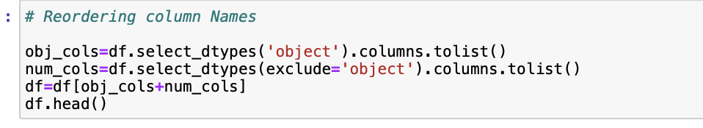

In Question 1, following tasks were accomplished
Data Loading
Rearranging the columns in such a way that categorical columns precedes numerical columns
Remove a column named ‘ID’ from the data frame.
Remove missing values from the database

Slide 5

Question 2
Multicollinearity
Multicollinearity is a phenomenon in multiple linear regression analysis where two or more independent variables are highly correlated, meaning they have a linear relationship with each other.
This poses challenges for machine learning model development because it violates the assumption that the independent variables are not highly correlated.

Slide 6
Challenges
Interpretation of Coefficients
Model Instability
Inflated Standard Errors
Reduced Predictive Power

Slide 7
Heat Map
On Clear Observing of the heatmap(inserted in next slide), it is evident that there is a multicollinearity issue with these data. The correlation between the variables is very high.
Multi-Collinearity Issues : We can see some variables are highly correlated with each other as follows 1) Price and Age (-0.9) - Strong Negative Correlation 2) Price and Mfg_Year (0.9) - Strong Positive Correlation 3) Age and Mfg_Year (-1.0) - Strong Negative Correlation

Slide 8
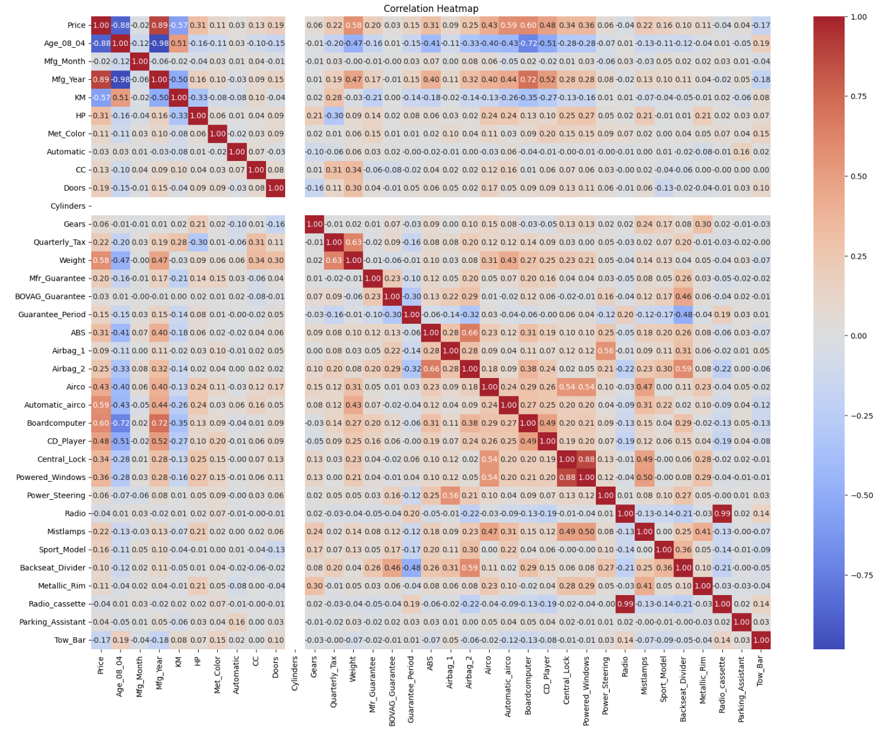
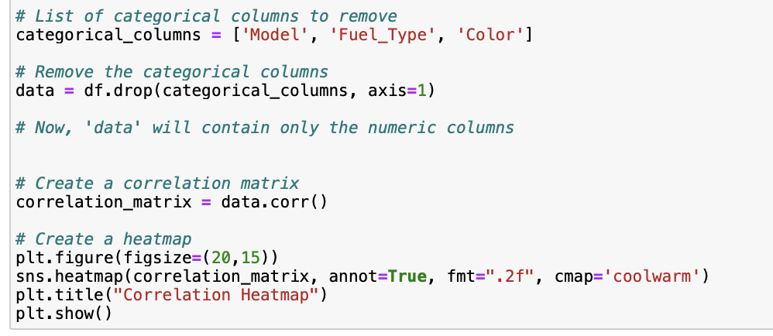

Slide 9
Dropping Variables :
By establishing a threshold value, we can eliminate one of the highly correlated variables, but this can result in the loss of crucial data and have an impact on the correctness of the model.
Principal Component Analysis Method: This method reduces the original dataset into a small set of features called principal components that include the necessary data.
Multi-Collinearity problems are lessened by regression techniques like the Lasso Regression method, which adds a term of penalty to prevent overfitting.

Slide 10

Question 3
In Question 3, following statistics are calculated using two variables price and KM.
Average price: 10730.824512534818
Average KM: 68533.25974930362
Variance of price: 13154872.100193106
Variance of KM: 1406733707.0021696
Price-KM Covariance is: -77534281.20595342
Proportion of total variance made up by Price: 0.00926472139701938
Proportion of total variance made up by KM: 0.9907352786029806

Slide 11
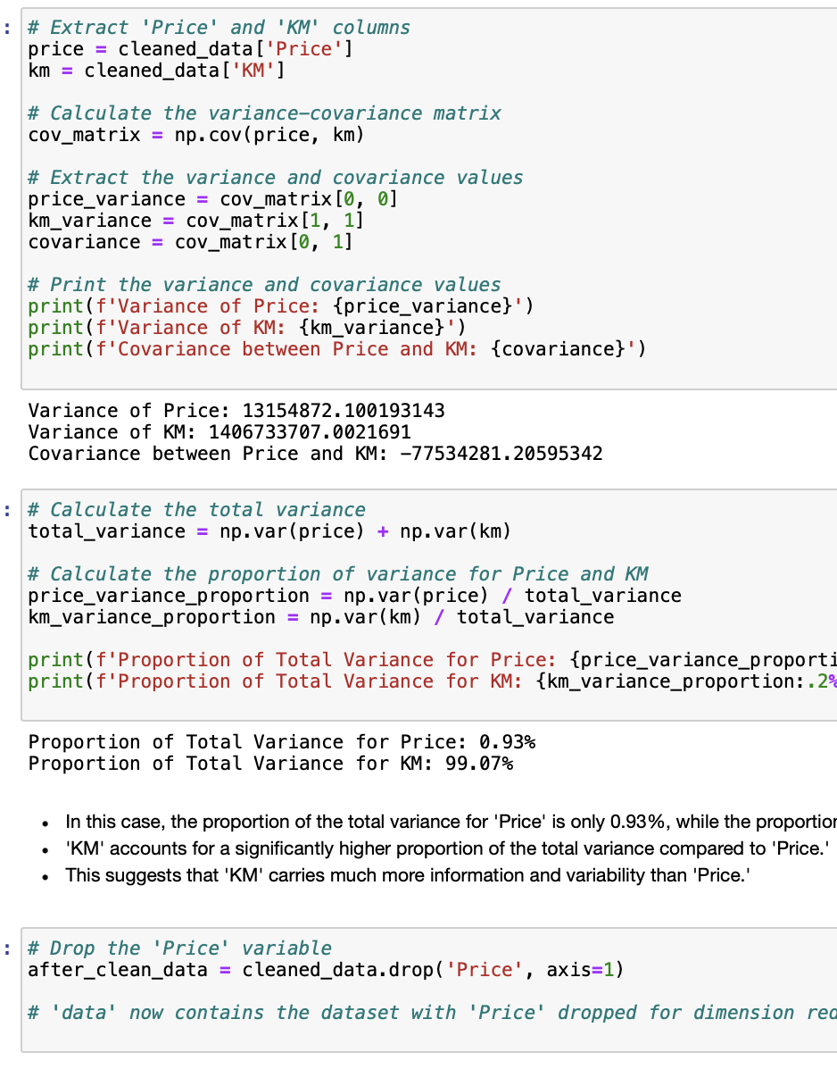
In Question 3, following statistics are calculated using two variables price and KM.
Average price: 10730.824512534818
Average KM: 68533.25974930362
Variance of price: 13154872.100193106
Variance of KM: 1406733707.0021696
Price-KM Covariance is: -77534281.20595342
Proportion of total variance made up by Price: 0.00926472139701938
Proportion of total variance made up by KM: 0.9907352786029806

Slide 12
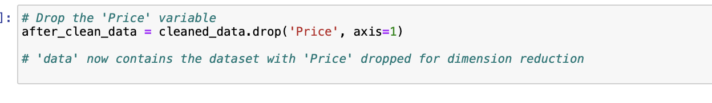
Dropping Variables for Dimension Reduction :
Yes, we can eliminate one of the variables in order to reduce the number of dimensions, but it's crucial to think about which variable to exclude and how doing so can impact your study.
To make sure that the variable you omitted is not actually making a major contribution to your research, it is preferable to compare the outcomes of your analysis with and without the dropped variable.

Slide 13
Question 4
The correlation between Price and KM is -0.57.
The above correlation information can be used to reduce the number of variables while making maximum use of their unique contributions to the overall variation.

Slide 14
1.How many principal components account for most of the variation in the original data?
To determine the number of principal components that account for most of the variation, we can look at the explained_variance_ratio.
2.Does it help to reduce dimensions in the data?
PCA is designed for dimensionality reduction, so it should help in reducing dimensions.
3.Should the data be normalized?
PCA works best when the data is standardized or normalized since it's sensitive to the scale of the variables.

Slide 15
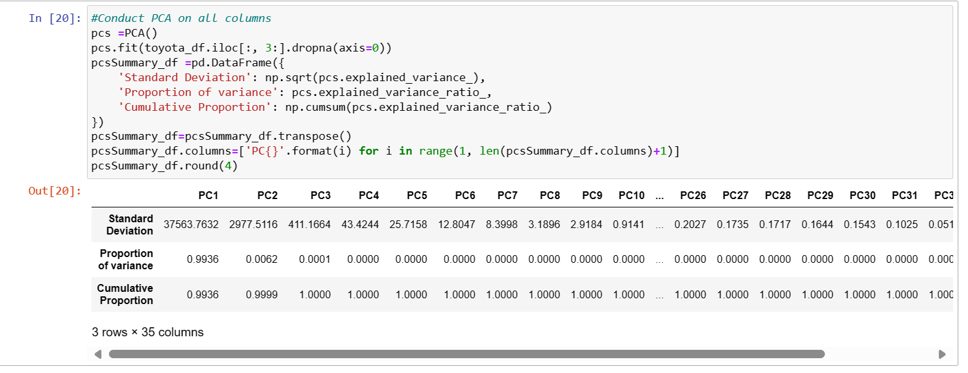
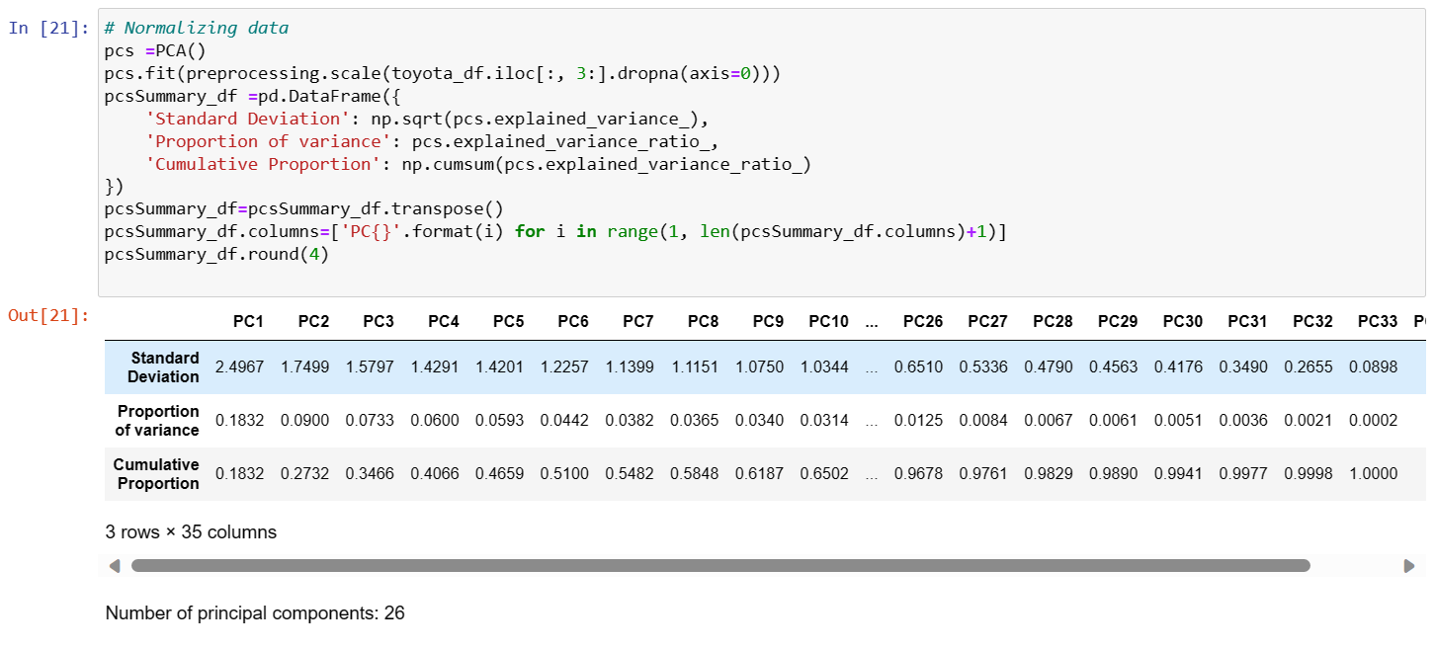

Slide 16
Number of Principal Components:
For the scaled data, we found that 31 principal components are needed to explain 95% of the variance.
After normalization, 24 principal components were sufficient to explain 95% of the variance.
Impact of Scaling:
Scaling the data had a notable impact on the number of principal components required.
In the scaled data, more components were needed to capture the same proportion of variance.
This indicates that scaling had the effect of making the data more comparable and reducing the dimensionality more effectively.
Interpretation:
The interpretation of the principal components may also differ between the two analyses.
The components themselves and their loadings on the original variables could be different due to the scaling or normalization process.

Slide 17
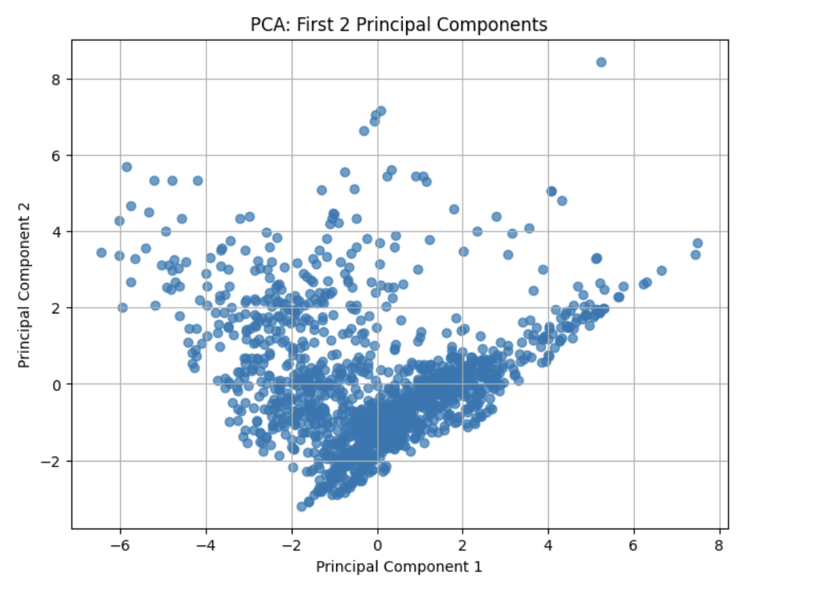
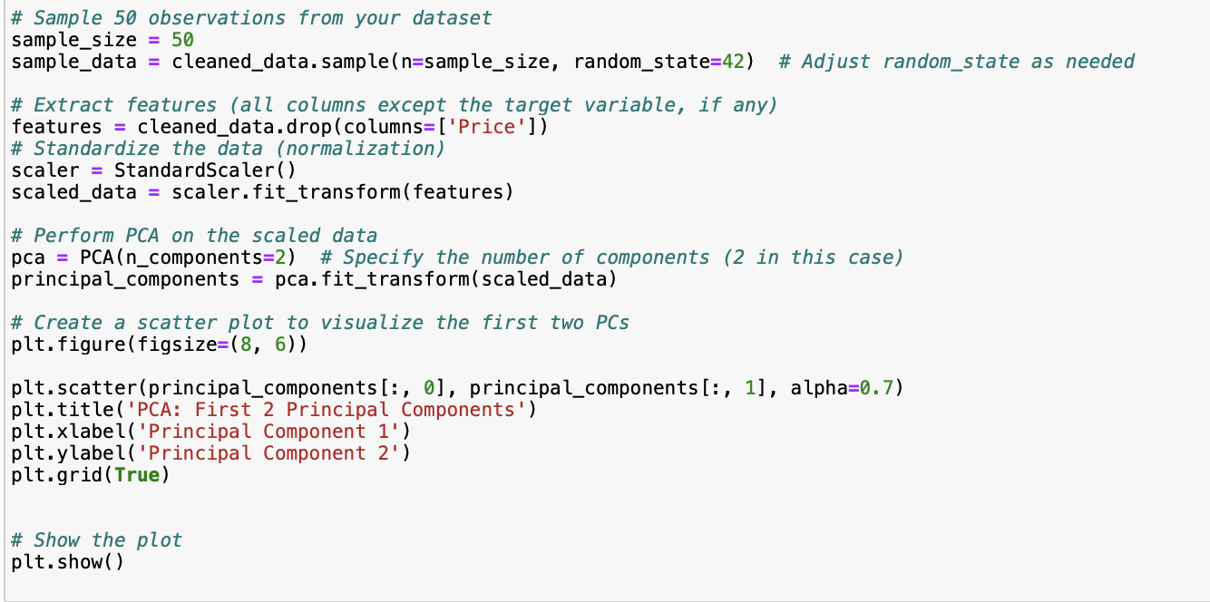
Question 5
Scatter plot of the first two principal components for first 50 observations

Slide 18

Thank you

